Slide 1
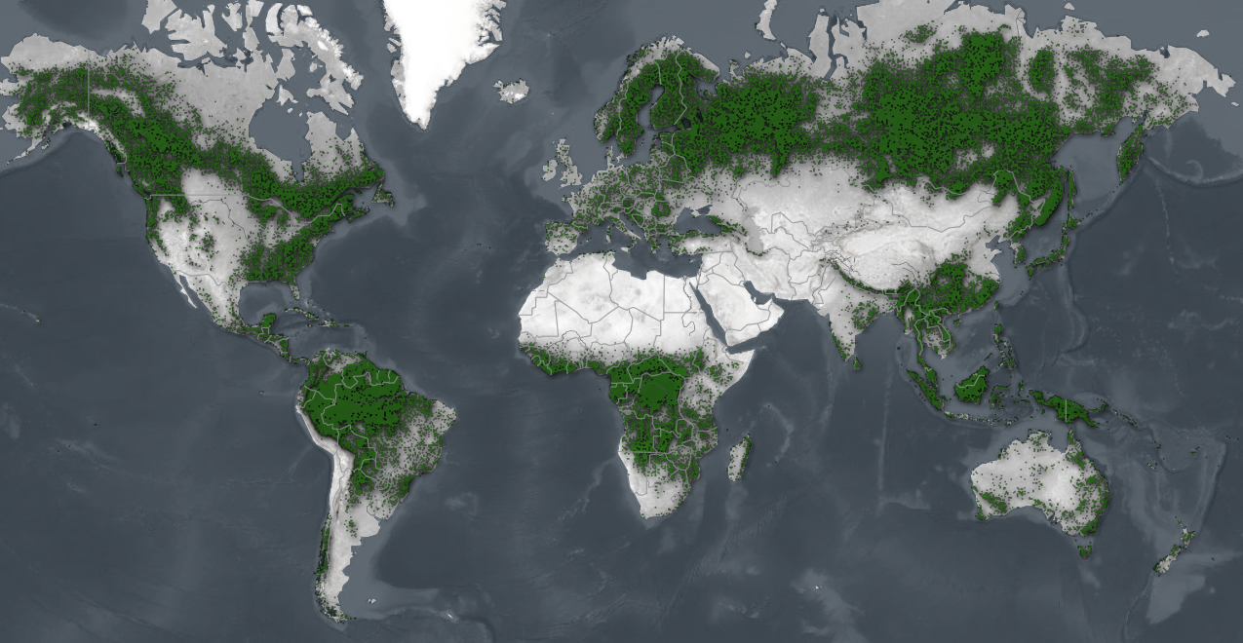

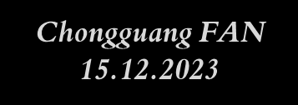
We cannot tackle the nature and climate crises or provide sustainable jobs without forests. And yet we are destroying them.
----WWF
Source: Esri / Sentinel-2 Land Cover Explorer

Slide 2
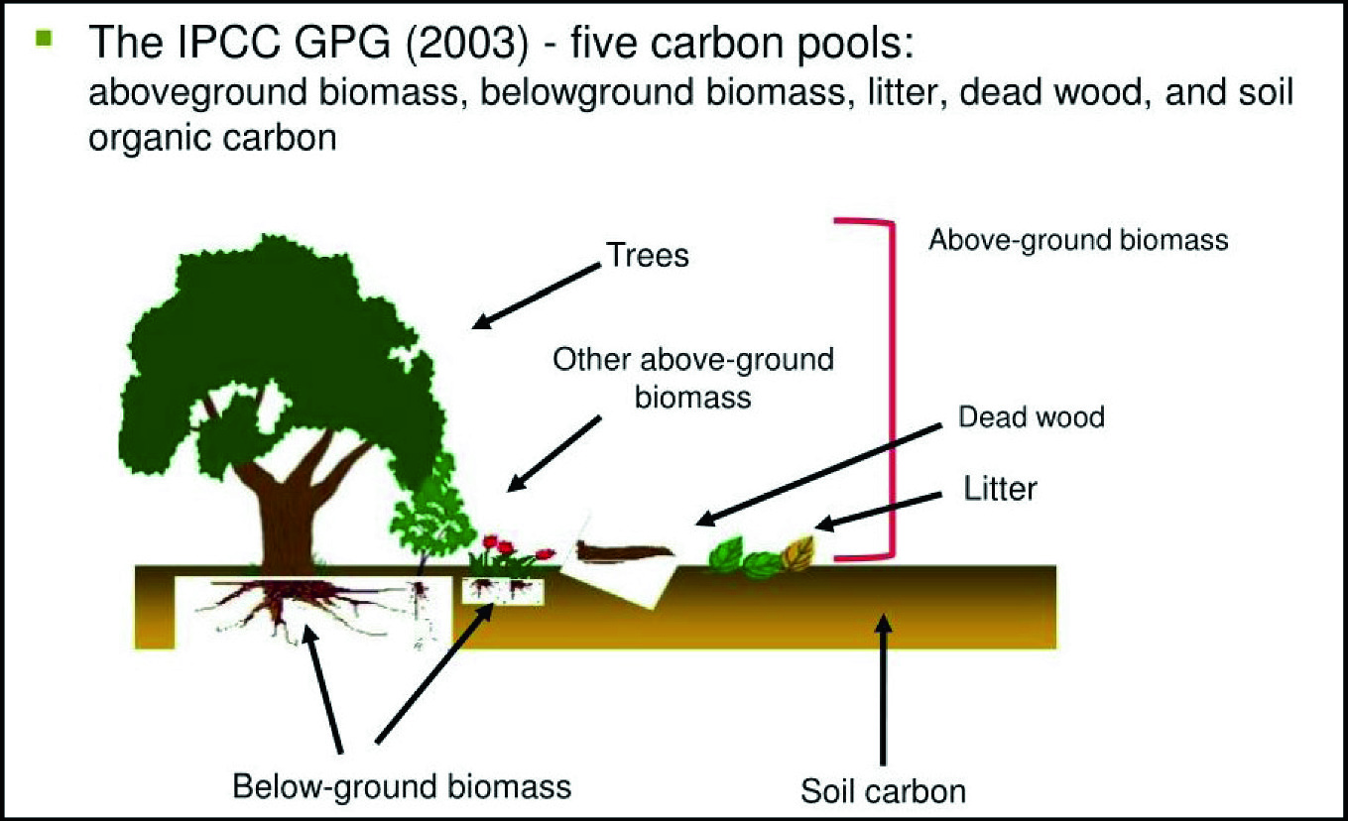
Forest aboveground biomass (AGB):
[Weights of living vegetation above the soil]
(stem, branches, foliage, etc.)
Aboveground biomass desnsity (AGBD):
Mg / ha (1 Mg = 1000 kg)
Indicator of forest status
Forest monitoring and management
AGB
Calculation of carbon storage
Climate change mitigation
2
Source: Ashton et al., 2012; Roy et al., 2020.

Slide 3
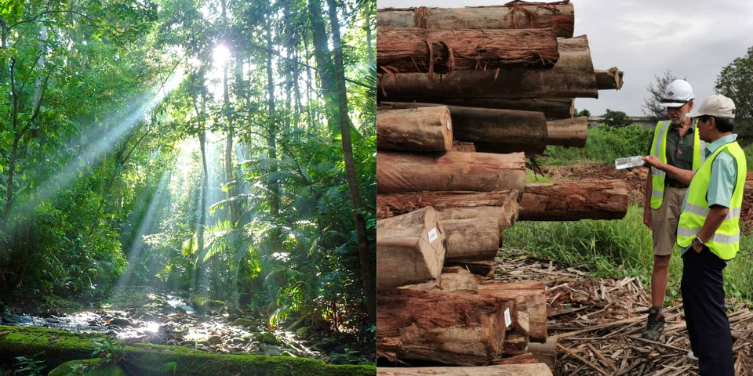
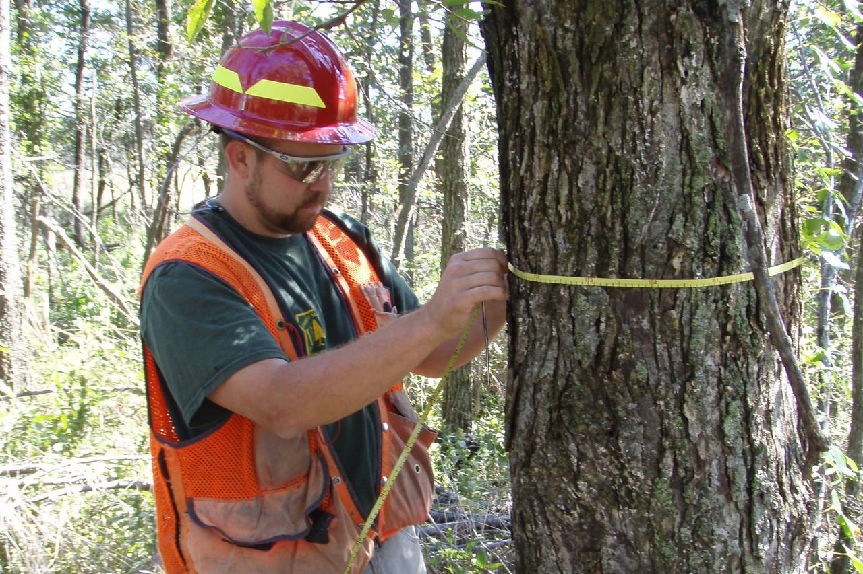
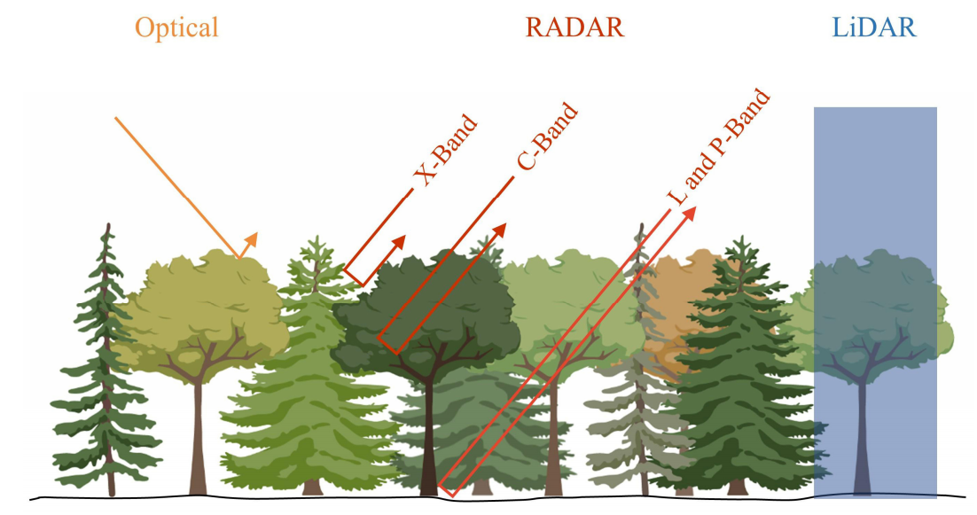
Traditional field survey
Harvest and weighing, allometric equations, etc. (plot scale)
Precise AGB measurement
AGB estimation in large areas
Vegetation index, backscatter coefficient, LiDAR metrics, etc.
Optical imagery, radar imagery, LiDAR (region scale)
Remote sensing
Source: https://sm.mashable.com/mashable_sea/photo/default/malaysia-deforestation-2023-header_mztm.png; https://s.wsj.net/public/resources/images/BN-RP616_NUMBER_M_20170112124801.jpg; Tian et al., 2023.
3

Slide 4
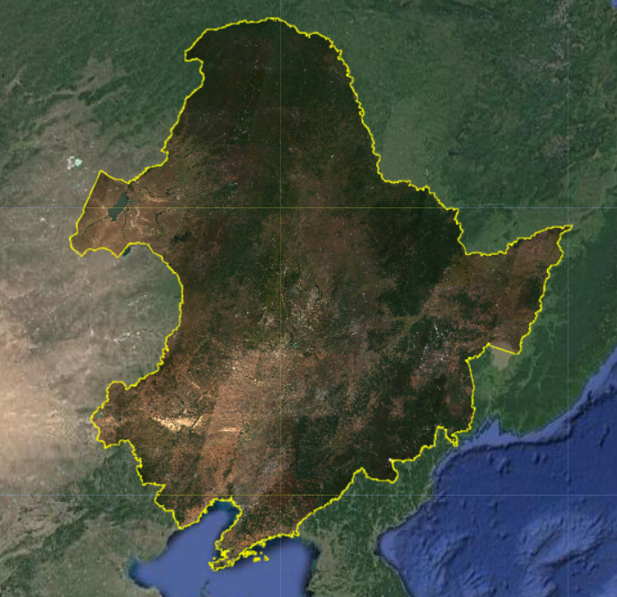
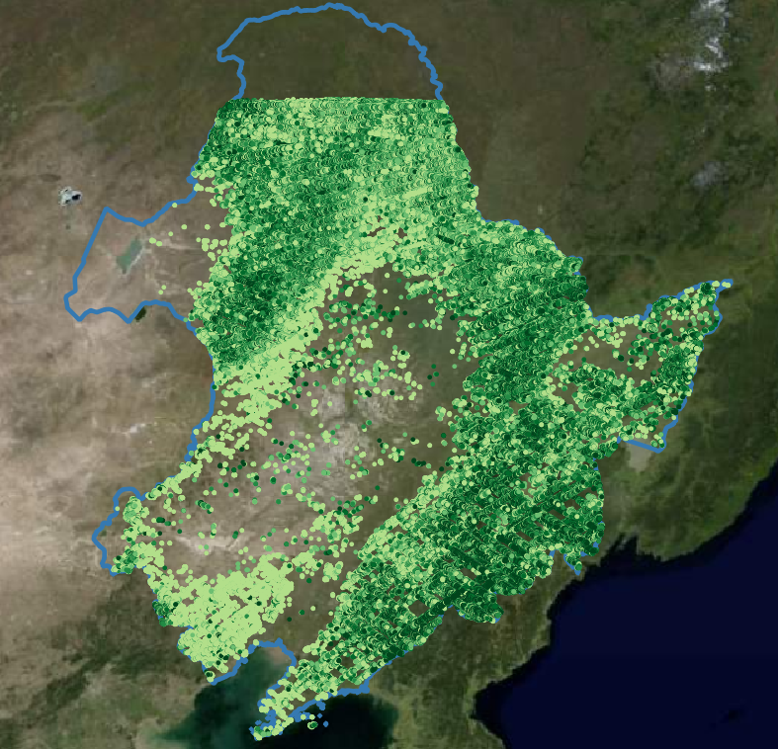
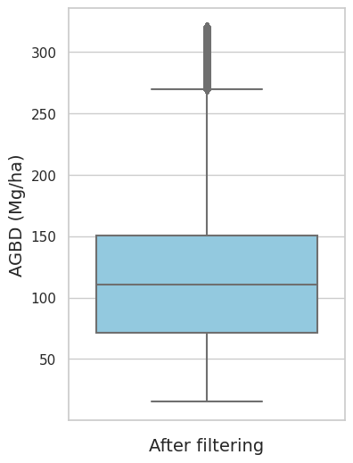
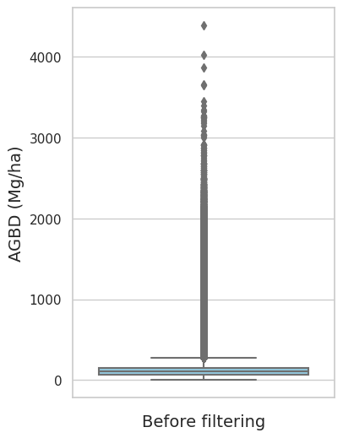

 | AGBD | Lat | Lon | Band1 | Band2 | … | Band12
0 | 63.10 | 45.37 | 123.09 | 0.025 | 0.029 | … | 0.083
1 | 75.70 | 46.33 | 125.61 | 0.028 | 0.026 | … | 0.060
2 | 71.38 | 46.33 | 125.61 | 0.028 | 0.026 | … | 0.069
… | … | … | … | … | … | … | …
5716319 | 93.83 | 44.85 | 130.71 | 0.039 | 0.033 | … | 0.108
Sentinel-2 L2A
GEDI L4A
Data filtration
P₁ ~ P₉₉
5,602,097 samples
5,716,320 samples

Slide 5




Train: 80%, Test: 20%
Train: 70%, Validation: 15%, Test: 15%
n_estimators = 50
Optimizer: Adam, Loss: MSE,
Epochs: 100, Batch size: 256, Callbacks: 10
1-D CNN
MLP
Conv1D (64, 3, ReLU) ×2
Hyperparameter | Range | Best
n_estimators | 50 - 2000 | 1261
max_depth | 100 - 1000 | 756
num_leaves | 1000 - 10000 | 6499
min_child_samples | 10 - 200 | 52
colsample_bytree | 0.5 - 1 | 0.64
subsample | 0.5 - 1 | 0.88
learning_rate | 0.01 - 0.5 | 0.04
Maxpooling (2)
Bayesian Optimization
init_points = 50,
n_iter = 100
Dense (128, ReLU)
Conv1D (128, 3, ReLU) ×2
Maxpooling (2)
Dense (64, ReLU)
Conv1D (256, 3, ReLU) ×2
Dense (32, ReLU)
Maxpooling (2)
Dense (16, ReLU)
Flatten
Dense (1, Linear)
Dense (128, ReLU)
Dense (1, Linear)

Slide 6

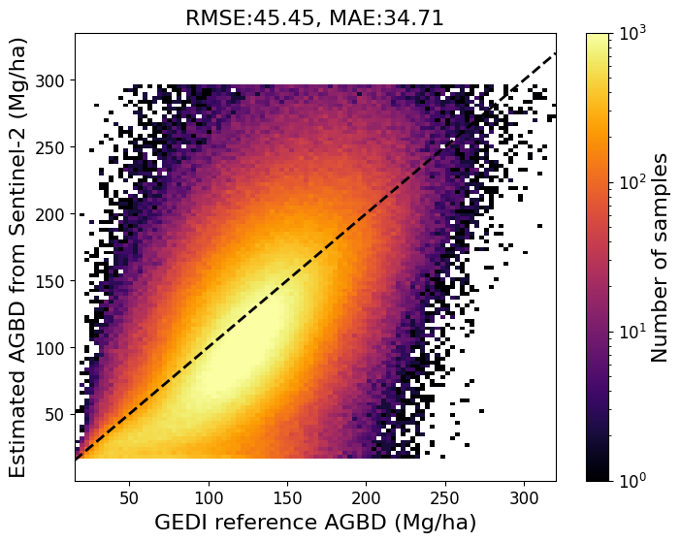
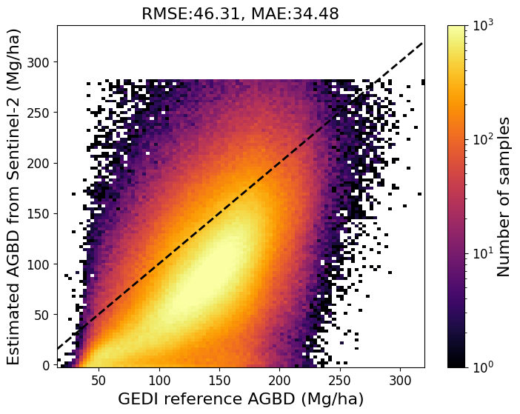
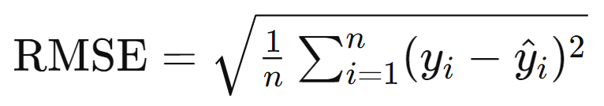
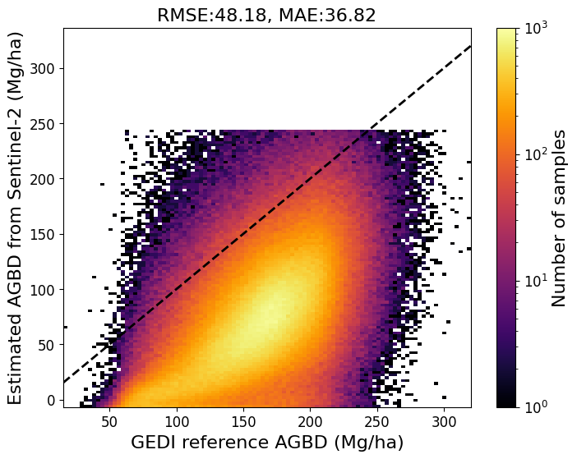
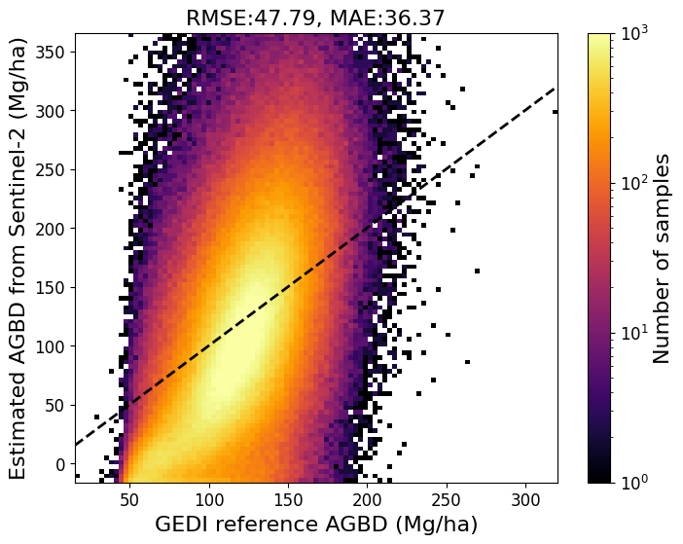
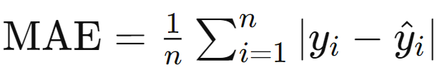
Evaluation metrics:
RMSE
(Root Mean Square Error)
MAE
(Mean Absolute Error)
Random Forest
Light GBM
ANN
1-D CNN

Slide 7
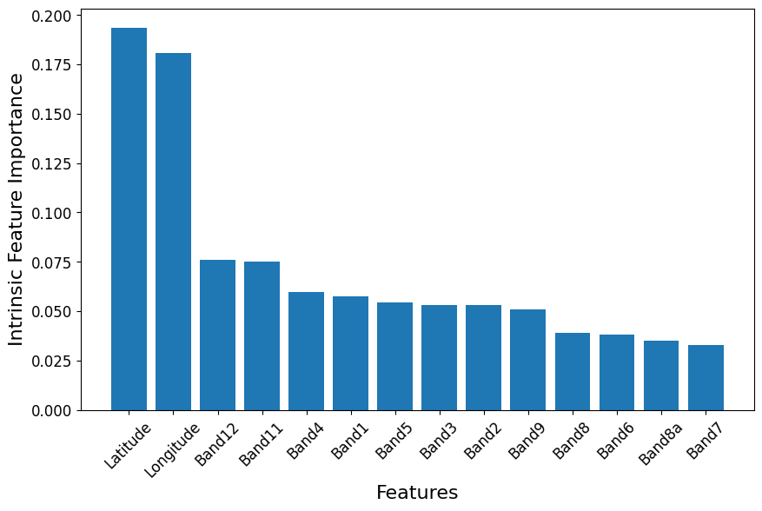
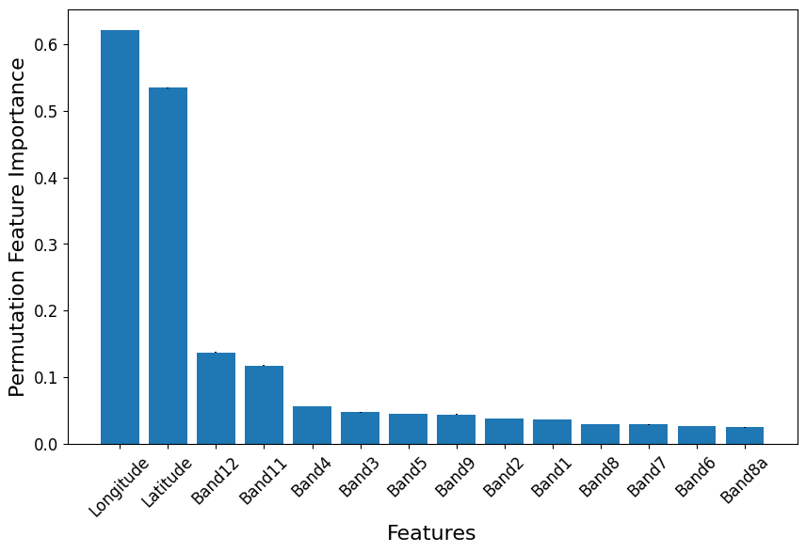
Latitude, longitude (location)
Band 12, 11 (short wave infrared)
More important features:
Intrinsic feature importance score
Permutation feature importance score

Slide 8

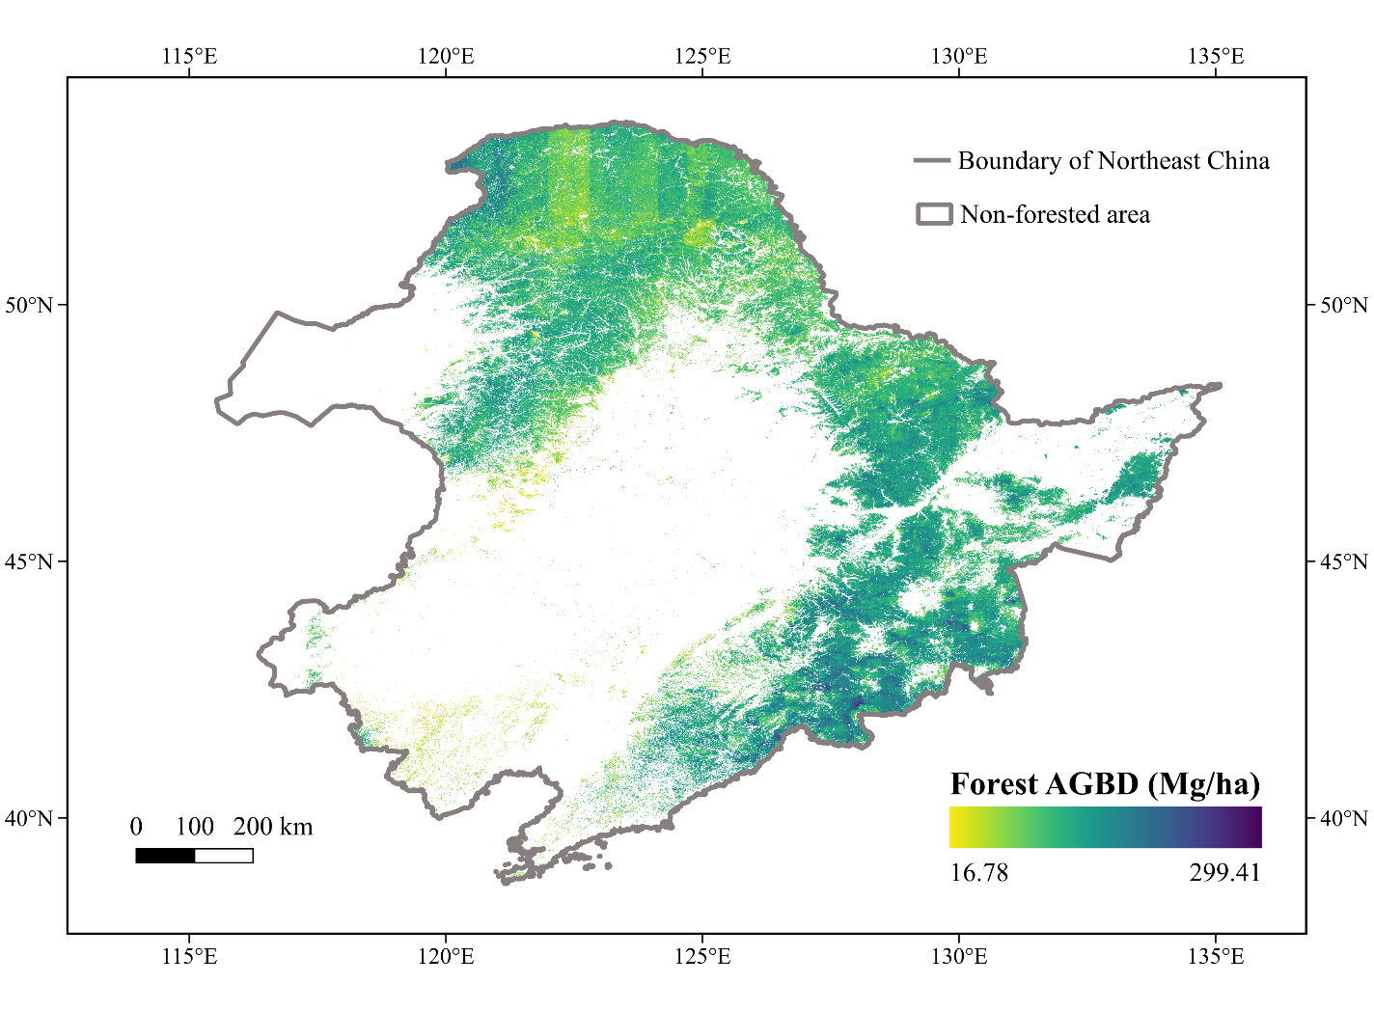

Strip effect
Independent evaluation
Uncertainty map
Expand space and time dimension
Other auxiliary data
Quality of GEDI L4A
10 m resolution forest aboveground biomass map
of Northeast China for the year 2022

